Slide 1
Note for the honourable teachers:
This slide is hidden.
Please start with F5 to keep it hide.
The subject teachers are requested to read the notes given below the slides.
A note is given bellow the slide no. 2, 4, 8, 14 .

Slide 2
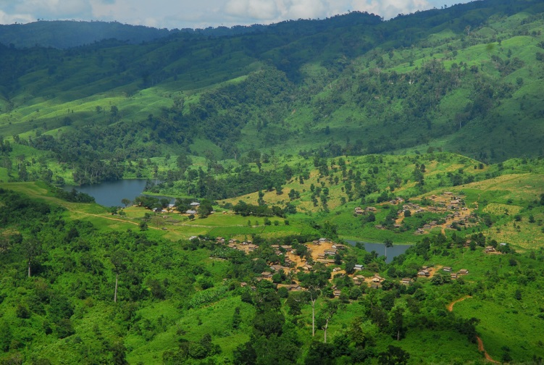
W
E
L
C
O
M
E
Notes:
The picture of Chittagong Hill Tracks.

Slide 3
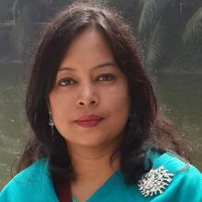
INTRODUCTION
ROUFUN NAHAR
ASSISTANT TEACHER ( ENGLISH)
MAZIDA GOVT. HIGH SCHOOL,
TONGI, GAZIPUR
CLASS: NINE-TEN
SUBJECT: ENGLISH 1ST PAPER

Slide 4
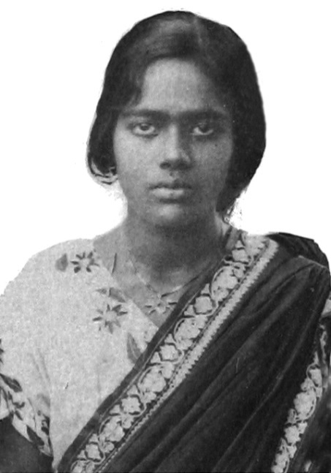
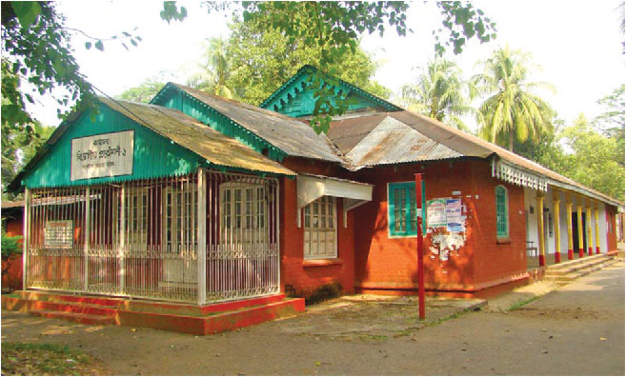
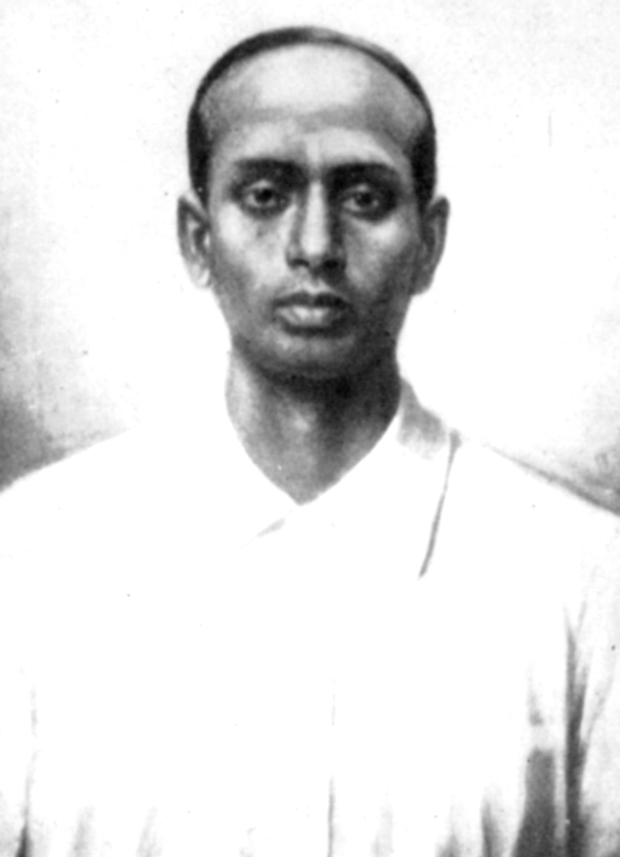
What do you know about them? Why are they well known?
Pritilota
Pahartali European Club
Surya Sen
Notes:
After the students talk about the pictures, the teacher can show their names and tell few information about the pictures, not in details.

Slide 5
Today our topic
They had dreams 1
Unit- 10
Lesson- 3

Slide 6
Learning Outcomes Of The Lesson
After this lesson the students will be able to-
1. talk about pictures.
2. listen for specific information.
3. read a text and find out information.
4. write about a person.
5. infer the word meaning from the text.

Slide 7
Listen the audio about Pritilata and choose the best answer.
1. Pritilota’s father was a ___________.
a) teacher b) doctor c) clerk d) engineer
$$$$
2. When did she pass her matriculation?
a) in 1921 b) in 1927 c) in 1929 d) in 1932
$$$$
3. The Chhatri Sangha was led by ____________ .
a) Lila Nag b) Pritilata c) Kalayani Das d) Lata Nag
$$$$
4. She became the headteacher of a local ________ .
a) Bangla medium high school b) primary school
c) English medium high school d) college
$$$$

Slide 8
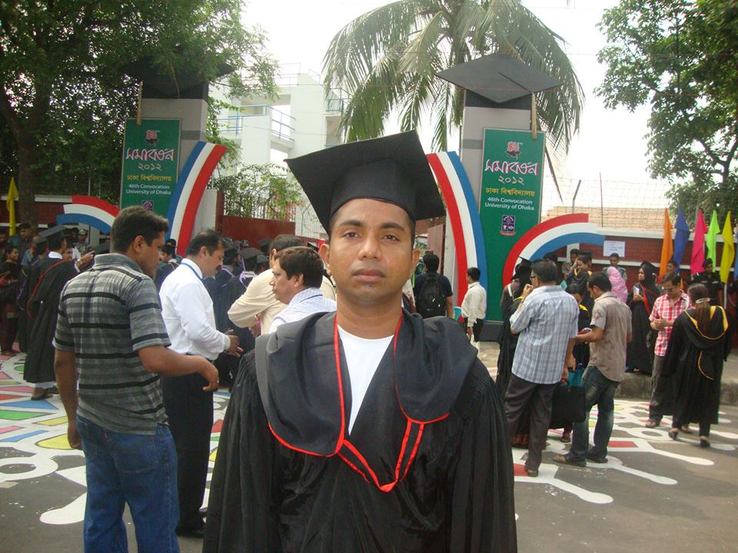
Graduate
Meaning
To achieve a university degree
Mr. Azim graduated from the University of Dhaka.
Notes:
First, the word will be shown. The SS will be asked to pronounce the word. If it is needed teacher can help. Then the picture and the sentence will be shown and asked to guess the meaning. After that the meaning will be shown. Then the teacher can ask the students to make a sentence of their own. In the same way, slide no. 7-11 can be conducted.

Slide 9
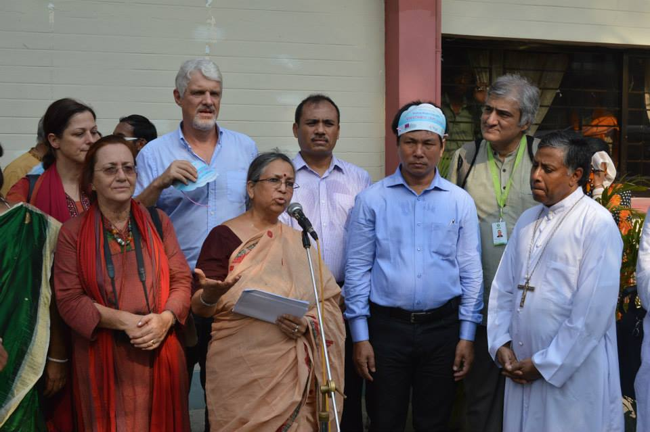
Activist
A member of a certain social or political group
Meaning
Mrs. Sultana Kamal is a human-rights activist.

Slide 10
Discrimination
different attitude to people , especially on the grounds of race, age, or sex;
Meaning
Women should not have any discrimination. They should have equal rights as men have.

Slide 11
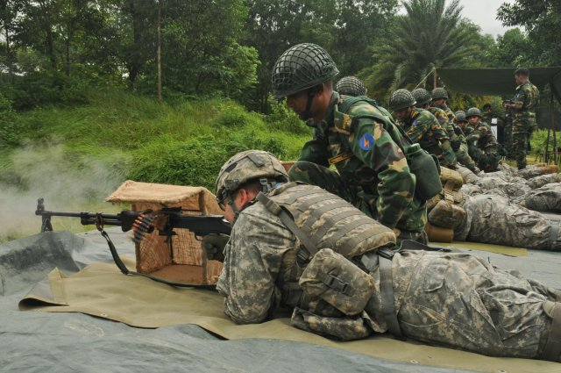
Combat
Meaning
fighting with arms/battle
The soldiers are having combat training.

Slide 12
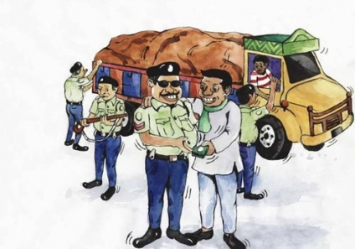
Notorious
Meaning
dishonourable
The police is taking bribe. It is a notorious deed.

Slide 13
Individual work
Read the text in the book and match the words in column A with the meanings in column B.

Slide 14
Read the text in the book and write the answers of the following questions.
Q 1. What did Pritilata dream for?
Q 2. Who was the mastermind of attacking of the Pahartali European Club?
Q 3. Why was the sign “Dogs and Indians not allowed” notorious?
Q 4. How did Pritilata prove that women can work like men?
Notes:
Answer may vary here.

Slide 15
Fill the gaps with suitable words from the box. Use right form of words if it is needed.
tell , name , injured, plan, commit, ideal, attack, found,
In 1932, Surya Sen a) __________ to attack the Pahartali European Club which had a signboard that read "Dogs and Indians not allowed” Pritilata was b) _______to lead the attack. Dressing herself as a Punjabi male, Pritilata with her team c) ___________ the club on September 23 at 10:45 pm. d)__________ and trapped by the British police, Pritilata swallowed cyanide and e) ___________ suicide to avoid arrest. Bangladeshi writer Selina Hossain calls Pritilata an f) _________for every woman. A trust named Birkannya Pritilata Trust has been g) _________ in her memory. A dormitory of Jahangirnagar University called Pritilata hall has been h) ________after Pritilata Waddedar.
planned
told
attacked
Injured
committed
ideal
founded
named

Slide 16
Homework
Mention the name of a woman who is your ideal. Why is she your ideal? Write it in ten sentences.

Slide 17
Acknowledgement
MoE, DSHE, NCTB & A2I respective of officials
And the editors panel: Ranjit Poddar, Associate Professor (English) TTC, Dhaka, Md. Jahangir Hasan (English), Assistant Professor TTC, Rangpur and Urmila Khaled Assistant Professor (English) TTC, Dhaka.
Their direction, valuable suggestions and intensive supervision have enriched the model contents.

Slide 18
Thank You All

